Slide 1
Method Overloading & Overriding

Slide 2

Method signature
Overloading methods Overriding methods
Overview
Understanding final and abstract methods
Assisted Practice: Calculating distances between points using method overloading

Slide 3
Method Signature
Is the combination of method name and method parameters.

Slide 4
void logFuelCapacity(String file) throws IOException { Path fileName = Path.of(file);
String content = "Remaining fuel: "+ this.remainingFuel; Files.writeString(fileName, content);
}
Method Signature Example
// Signature = name + parameter list logFuelCapacity(string)
double getTakeOffWeight(double luggageWeight,
int nbPassengers) { int AVG_PERSON_KG = 80;
return luggageWeight + (nbPassengers * AVG_PERSON_KG);
}
// Signature = name + parameter list getTakeOffWeight(double, int)

Slide 5
Method Overloading
A class can have multiple methods with the same name if their parameter lists are different.
The differentiation is made by the number and type of the parameters.

Slide 6
Without Method Overloading
double calculateTakeOffWeight(double luggageWeight, int nbPassengers) { int AVG_PERSON_KG = 80;
return luggageWeight + (nbPassengers * AVG_PERSON_KG);
}
double calculateTakeOffWeightWithPassengersWeight(double luggageWeight,
double passengersWeight) {
return luggageWeight + passengersWight;
}
double calculateTakeOffWeightWithPassengersAndFuelQuantity(double luggageWeight,
double passengersWeight,
int fuelQuantity) {
return luggageWeight + passengersWight + fuelQuantity;
}

Slide 7
Not using overloading would result in providing different names for the same intent.

Slide 8
Method Overloading
double calculateTakeOffWeight(double luggageWeight, int nbPassengers) { int AVG_PERSON_KG = 80;
return luggageWeight + (nbPassengers * AVG_PERSON_KG);
} // calculateTakeOffWeight(double, int)
double calculateTakeOffWeight(double luggageWeight, double passengersWeight) { return luggageWeight + passengersWight;
} // calculateTakeOffWeight(double, double)
double calculateTakeOffWeight(double luggageWeight, double passengersWeight,
int fuelQuantity) {
return luggageWeight + passengersWight + fuelQuantity;
} // calculateTakeOffWeight(double, double, int)

Slide 9
Incorrect Method Overloading
Different return type only
Type erasure

Slide 10
Incorrect Method Overloading
Different Return Type Only
double calculateTakeOffWeight(double luggageWeight, double passengersWight) { return luggageWeight + passengersWight;
}
int calculateTakeOffWeight(double luggageWeight, double passengersWight) { return (int) (luggageWeight + passengersWight);
}
// Incorrect, the compiler will complain

Slide 11
Incorrect Method Overloading
Type Erasure
double calculatePassengersWeight(List<Integer> weights) { return weights.stream().reduce(0, Integer::sum);
}
double calculatePassengersWeight(List<Double> weights) { return weights.stream().reduce(0.0, Double::sum);;
}
// After compilation calculatePassengersWeight(List)
// Incorrect, the compiler will complain

Slide 12
Type Erasure
The Java compiler replaces all type parameters in generic types with their bounds or Object if the type parameters are unbounded. The produced bytecode, therefore, contains only ordinary classes, interfaces, and methods.
Type Erasure (The Java™ Tutorials > Learning the Java Language > Generics (Updated)) (oracle.com)

Slide 13

Type Erasure Example
Bytecode Representation
// access flags 0x0
// signature (Ljava/util/List<Ljava/lang/Double;>;
)D
// declaration: double calculatePassengersWeight(java.uti l.List<java.lang.Double>)
double calculatePassengersWeight(List<Double> weights) {
// implementation
}
calculatePassengersWeight(Ljava/ util/List;)D

Slide 14
Method Overriding

Slide 15
Method Overriding
The ability of a subclass to provide a different implementation to a method defined in the parent class.
The overriding method has the same name, number and type of parameters and return type as the one declared in the base class.

Slide 16
Overriding Example
Aircraft.java
Helicopter.java
class Aircraft {
public void land() { System.out.println("Aircraft landing");
}
}
class Helicopter extends Aircraft { @Override
public void land() { System.out.println("Helicopter landing");
}
}

Slide 17
Aircraft a = new Aircraft(); Aircraft h = new Helicopter();
a.land();
h.land();
// Output => Aircraft landing
// Output => Helicopter landing
Overriding Is a Way to Implement Polymorphism
The version of a method that gets executed is determined at runtime, by the object that is used to invoke it

Slide 18
Overloading vs. Overriding
Overloading
Determined at compile time Overloaded methods are declared in
the same class
Different signatures Mostly used for naming consistency
Overriding
Determined at runtime
Overridden methods are defined in subclasses
Same signature
Used to implement polymorphism

Slide 19
Final Methods

Slide 20
What if I don’t want anyone else to override my methods?
You

Slide 21
The ‘final’ method modifier
Can be used to mark that a method can not be overridden.

Slide 22
The ‘final’ Modifier Example
Aircraft.java
Helicopter.java
class Aircraft {
public final void land() { System.out.println("Aircraft landing");
}
}
class Helicopter extends Aircraft { @Override
public void land() { System.out.println("Helicopter landing");
}
}
// Incorrect

Slide 23
Declare final methods when you feel that a method should never be overridden, or it is very difficult to override correctly.

Slide 24
public class Thread {
public final void setPriority(int newPriority) {}
}
public class File {
public final FileDescriptor getFD() throws IOException {}
}
Final Methods in Java API
You would not want to override the behavior of these methods. That is why they are marked as final.

Slide 25
Abstract Methods

Slide 26
Abstract Method
A method declared without an implementation.
The ‘abstract’ modifier is used to mark a method as abstract.

Slide 27
Abstract Class
A class that can not be instantiated. It is meant to be extended and used as a baseline by more concrete classes.

Slide 28
Use abstract methods to force subclasses to provide an appropriate implementation for a given behavior.

Slide 29
Implement Abstract Methods
It would be very unrealistic to expect the same landing procedure for all subclasses
However, they need to implement this action, but in their own way
An abstract landing method can be used. We abstract, but we leave freedom to subclasses to come with their own landing behavior in a consistent way.
Aircraft
abstract void land()
Airplane
Helicopter
Glider

Slide 30
public abstract class Aircraft { private int altitude;
// Too complex to be abstracted public abstract void land();
Abstract Method Example
public int getAltitude() { return this.altitude;
}
}
Aircraft a = new Aircraft(); // Can’t instantiate

Slide 31
Implementing Abstract Methods
Use Subclasses and Override the Abstract Method
Helicopter.java
Glider.java
public class Helicopter extends Aircraft { @Override
public void land() {
// Complex logic that handles
// helicopter landing
}
}
Aircraft h = new Helicopter(); h.land();
public class Glider extends Aircraft { @Override
public void land() {
// Complex logic that handles
// glider landing
}
}
Aircraft g = new Glider(); g.land();

Slide 32

Assisted Practice
Calculating distances between points using various parameters using method overloading

Slide 34
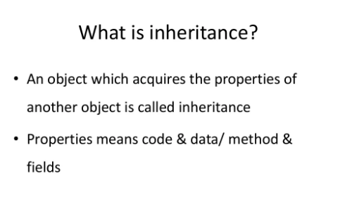

Slide 35
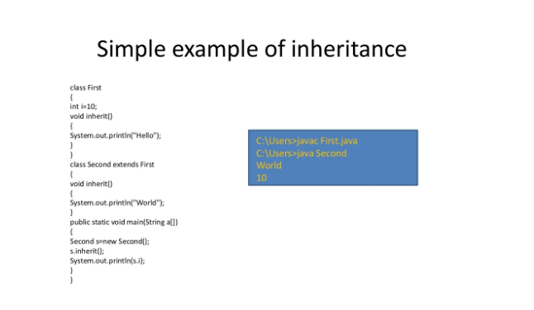

Slide 36
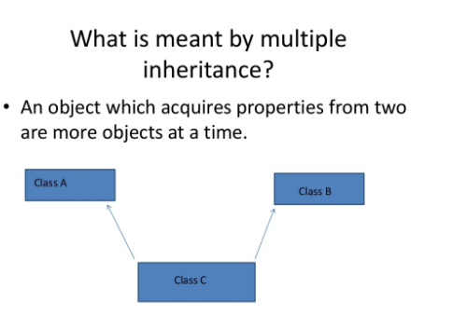

Slide 38
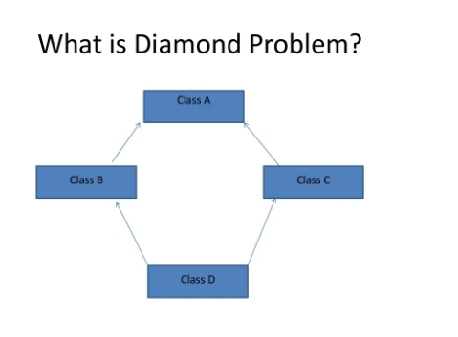

Slide 39
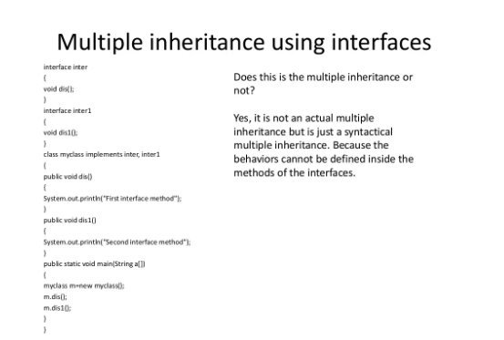

Slide 40
The method signature is made up of the method name and its parameter list
We can create methods with the same name in a class if they have different signatures. This is called method overloading
When using inheritance, you can completely rewrite the body of a method to provide a more appropriate implementation. This is called method overriding
If you want to block overriding, you can declare methods as final
If you want to define a method without any body and force subclasses to provide the implementation, you can declare that method as abstract
The Diamond Problem of Multiple Inheritance
Summary

